Slide 1
Target Enumeration and port scanning
Part – back to 72 ethical hackers
By- l4kky gfso3 |save|
Query - #BACKTO72QUERY

Slide 2
Enumerating and scanning
Goal: gain as much information about the alive target on a network as possible. Part of Information gathering. We have gathered helps us to compromise targets.
Host discovery
Scanning for open ports
Service and version detection
OS detection
Bypassing Firewalls

Slide 3
001_HOST discovery
The first step of network pentest most time would be to target is alive or not.
This is not possible to pentest a target that is not alive without physical accesses. We look for alive target.
Ping requests to check target alive or not
If we get reply that means target is alive.
$ nmap –sP <targe host>
-sP flagin namp check target alive or not. We can specify network ranges to scan.
$ nmap –sP 192.168.0.0/24

Slide 4
Implementation of IDS, IPS, Firewalls, and other modern defence on the network identifying alive hosts can be a bit trivial.
Network administrators commonly block ICMP requests. We do not able to figure it out that target is alive or not.
We can use TCP and UDP protocols to figure out it the target is alive or not.
We use a website which block ICMP requests. Didx.net
$ nping didx.net
Block all requests
We use namp –tcp didx.net
We can see 0% packet lost;
We can use UDP to perform host discovery.

Slide 5
0010_Open ports and Services
We can scan alive hosts on a network.
We can now scan for open ports and services on a network which is alive host.
Port Scanning: TCP and UDP open ports on the target host or network.
Open ports revel the service running upon the network.
Why we use port scanning ? : look for potential entry points into the system.
Challenging task : port scanning is to evade firewalls and intrusion detection and prevention mechanism.
Goal : make scan less noisy.

Slide 6
Type of port Scanning
Port scanning Two category : TCP and UDP scanning
Nmap is tool for network scanning. This available for cross-platform (linux, windows, Mac OS).
How to use nmap:
$ nmap <Scan Type> <Options> <Target Specification>
Simple port scanning
$ namp <target IP Address>
$ namp 192.168.1.1/* CIDR notaion that we used ranges or using * sign.

Slide 7
_TCp Three-way handshake
TCP:: TRANSMISSION CONTROL PROTOCOL
SYN >> << SYN/ACK ACK>>
First host send SYN packet to the second host
Second host responds with SYN/ACK packet that means packet received.
First host completes the connection by sending an acknowledgment packet.
Second Host
HOST

Slide 8
TCP Flags
SYN – Initiates a connection
ACK – Acknowledges that the packet was received
RST – Resets the connections between two hosts
FIN – Finishes the connection.

Slide 9
0011_Port status types
With NMAP four port status types:
Open – port open and application listening on it.
Closed – port is close we do not access this and application not listening it.
Filtered – NMAP not figure to port is open or close as the packets are filtered which is probably means that the machine is behind firewalls.
Unfiltered – Ports are accessible by NMAP but it is not possible to figure out if they are open or closed.

Slide 10
TCP SYN Scan
This default scan that runs against the target machine. It is the fastest scan.
Using the –n options which would tell the NMAP to skip DNS resolution.
-p : which port want to scan
$ nmap –sS -n <target IP> -p 80

Slide 11
TCP Connect scan
Similar to SYN scan, with a slight difference in that it completes the three-way handshake. TCP connect scan becomes the default scan if the SYN scan is not supported by the machine. Machine is not privileged to create its won RAW packet.
Source(192.168.0.8) ----------------SYN + port 80-------→ Destination (192.168.0.10)
<-----------SYN/ACK----------------
|-------------------ACK-and RST----------------------^-

Slide 12
NULL, FIN and XMAS Scans
Why?: get past firewalls and IDS and can be really beneficial against Unix-based OS as all these scans do not work against Windows-based OS.
Because they a reset packet regardless of whether the port is open or closed.
Disadvantage is that it cannot be exactly determined if the port is open or closed or filtered.

Slide 13
NULL Scan
Sending no flags / bits inside the TCP header.
If no response means port is open
If response is RST packet received means that the port is closed or filtered.
$ nmap –sN <target IP Address>

Slide 14
Fin scan
FIN flag is used to close a currently open session.
FIN scan the sends a FIN flag to the target machine if no response comes from the target machine, it means that the port is open, if target machine responds with a RST, it means that the port is closed.
$ nmap –sF <target IP Address>

Slide 15
XMAS scan
XMAS scan sends a combination of FIN, URG and PUSH flag to the destination.
It works like FIN and NULL scans.
If no response port Is open if response port is close.

Slide 16
TCP ACK scan
Not used for port scanning purposes.
Use for determine the firewall an ACL rules (access list) and whether the firewall is able to keep track of the connections that are being made.
If the firewall is stateful, it would know that the there was no SYN packet being send and well not allow the packet to reach the destination.
Response : no response this means firewall is stateful and it’s filtering your packets.
If no receive a reset packet, it means that the packet reached the destination.
$ nmap –sA <target IP Address>

Slide 17
0100_UDP port scan
UDP: USER DATAGRAM PROTOCOL
It does not ensure the reliability of the communication and is not used for communication, where the data are important to us.
Many ports UDP used.
UDP port scan can be used to determine the common services that are listening upon UDP.
UDP services : DHCP, SNMAP, DNS
UDP port scan works by sending an empty UDP header, UDP response from the target port is open. No response port is open or it is filtered.
Port is closed is ICMP error massages can be showed. ICMP messages “ICMP Port unreachable error”
$ namp –sU <target IP Address>

Slide 18
0101_ Anonymous Scan type
Mean:: your host IP would not be revealed at the destination when you are performing port scanning.

Slide 19
IDLE Scan
This is effective and stealthy scanning technique.
Why ? : IDLE scan is to introduce a zombie to scan another host.
The victim host would be receive packets from zombies host not from attacker host. In this way victim not figure out where the scan originated.
How To? :: Good candidate whose IP ID sequence is incremental and recording
Host should be IDLE on the network

Slide 20
Scanning for a Vulnerable host
Vulnerable host for zombie scan.
Tool:: HPing2 for figuring out if a host is good candidate for an IDLE scan.
HPing2 used for firewall testing purpose.
$ hping2 –S –r <target IP>
S – sending SYN flag
R – relative ID

Slide 21
Performing AN idle scan with nmap
Simply performed by specifying the –sI parameters with NMAP
$ nmap –sI <IP Address of Zombie> <IP Address of the Target>

Slide 22
0110_TCP FTP bounce scan
Scan exploits a vulnerability inside old FTP servers that supports a proxy-based FTP connections.
This vulnerability allowed the users to connect to the FTP server and send files to a third-party server.
Done by asking the server to send a file to a specific port on the target machine. This way the attacker could remain anonymous , while doing this.
Nmap gives you the flexibility to test if a target FTP server is vulnerable or not
$nmap –b <target FTP Server>

Slide 23
0110_Service version detection
We find the exact version of the service running on a port.
Help:: this to help to find or look for the potential exploits for that particular version of the service.
NMAP had a database named namp-service that contains more than 2200 well-known services.
For service detection can be performed by specifying the –sv parameter to the NMAP.
$ namp –sV <target IP>

Slide 24
0111_OS fingerprinting
OS :: Operating System
NMAP OS database with more than 2600 OS fingerprints.
Sends target machine TCP and UDP packets and received and compared with the database.
If the fingerprints matches, it display the results was showing.
$ nmap –O <Target Address>
Nmap OS limet this is save more time Use the –A command to perform both OS and service version detection.
$ nmap –n –A –T5 <target IP>
-n –T5 speed up our scan.
OS detection and service detection methods are very loud at the other end and are often easily detected by IDS and IPS

Slide 25
POF – Passive os fingerprinting
Name is suggest it does not directly engage with target while performing OS fingerprinting.
It monitors and tries to identify the TCP stack, and based on the TCP stack type it figure out the type of OS.
This is from documentation of POE:
Common uses for POF include reconnaissance during penetration tests; routine network monitoring; detection of unauthorized network interconnects in corporate environments; providing signals for abuse-prevention tools; and miscellaneous forensics.

Slide 26
0111_Advanced firewall/IDS evading techniques
This techniques are very loud in nature and often detected by firewall and IDS.
XMAS, FIN and NULL are not that accurate also they don’t work on the Windows OS.
This method work some firewall/IDS but fail with others.
NMAP have wide variety of techniques that could be used.
Timing technique.
Fragmented packets
Source port scan
Specifying an MTU
Sending bad checksums

Slide 27
Timing technique
Best technique to evade firewalls/IDS.
Idea behind this it to send the packet gradually, so they do not end up beging detected by firewall/IDS.
Nmap launch timing scan by the T command range 0-5. Increasing the values from T0 to T5 would increase the speed of the scan.
T0 – paranoid
T1 – Sneaky
T2 – Polite
T3 – Normal
T4 – Aggressive
T5 – insane
$ nmap –T1 <target IP>

Slide 28
Fragmented packet
We split the packets into small chunks making it harder for the IDS to detect.
IDS would analyse a single fragment but not all the packet.
Modern IDS can rebuild the fragments into a single packet making them detectable .
$ nmap –f <target IP>

Slide 29
Source port scan
Network administrator to allow traffic from a certain source port.
We can use this to our advantage to bypass badly configured firewall. Common ports sources are 53, 80 and 21.
$ nmap –PN –g 53 <target IP>
-g specify a source port in this case is 53 (DNS)

Slide 30
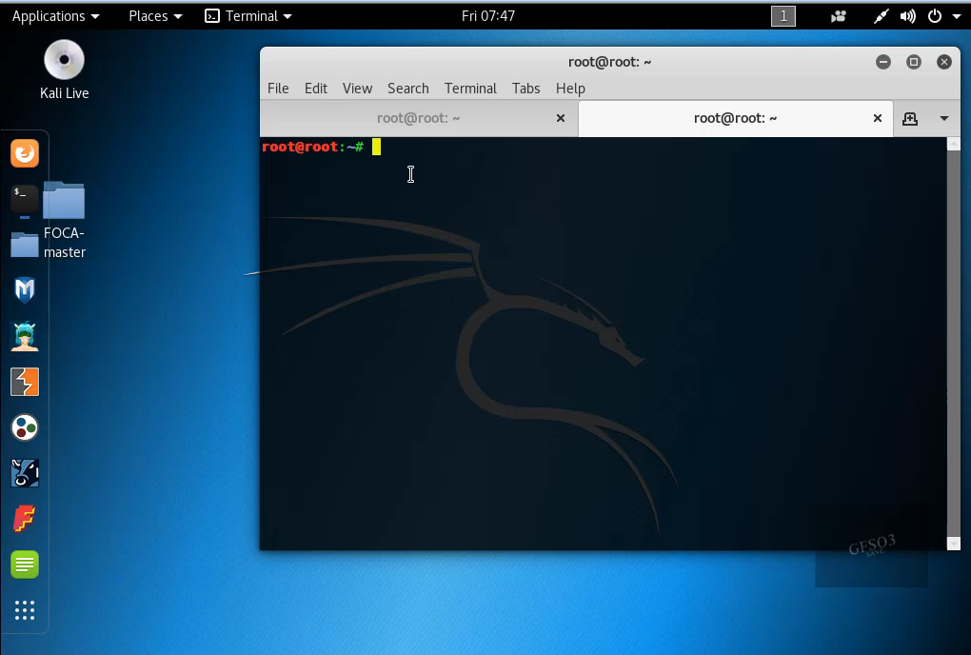
Do this

